Slide 1
Equivalence Relations
Jorge Cobb
The University of Texas at Dallas

Slide 2
Review questions
What is the reflexive closure of the relation {(x, y): x≠y} on the set of integers?
Let R be the relation that contains a pair (x, y) if there is a direct flight from city x to city y. What is the meaning of (x, y) ∈ R³?
Apply the theorem discussed in class to find the transitive closure of the relation {(2, 1), (2, 3), (3, 1), (3, 4), (4, 1), (4, 3)} on the set {1, 2, 3, 4, 5}.

Slide 3
Two major kinds of relations
Equivalence relations
  reflexive
  symmetric
  transitive
Partial orders
  reflexive
  antisymmetric
  transitive

Slide 4
EQUIVALENCE RELATIONS

Slide 5
Example equivalence relations
The relation “=” on any set of numbers (integers, reals, or any subset thereof)
What about relation R on the reals such that a R b iff a – b is integer.
  Reflexive? a R a?
  Symmetric? a R b ➔ b R a?
  Transitive?
    (a - b) integer, and (b - c) integer, (a – c) integer because (a – c) = (a – b) + (b – c), both are integers

Slide 6
Another example
The relation “x = y (mod m)” on integers, where m > 1, or congruence modulo m. Recall that
  x = y (mod m) iff m divides x – y
  Reflexive?
    x – x = 0 which any m divides
  Symmetric?
    If m divides x – y and the divisor is k, then m divides y – x with divisor – k
  Transitive?
    If x – y = km and y – z = lm, then x – z = (x – y) + (y – z) = km + lm = (k + l)m
BTW, x = y (mod m) iff (x mod m) = (y mod m)

Slide 7
Other examples
What about the “divides” relation on the set of integers?
  reflexive, transitive, but not symmetric
What about the relation {(x, y): |x – y| < 1} with x and y real numbers?
  reflexive; |x – x| = 0 < 1
  symmetric; |x – y| = |y – x|
  not transitive; for example, x = 1, y = 1.8, z = 2.5

Slide 8
Equivalence classes
Two elements x and y that are related by an equivalence relation are called equivalent (with respect to that relation). We denote this by x ∼ y (also x R y for relation R)
The set of all elements related to x is called the equivalence class of x, denoted [x]_{R} or [x] if the relation is understood.

Slide 9
Let
a
b
denote that element a is related to element b
Let
c
d
denote that element c is related to element d
AND element d is related to element c
Consider the graph in the following slide.

Slide 10
Is this an equivalence relation?
What is the smallest # of pairs (arrows) needed to turn it into an
equivalence relation?
If you take the reflexive, symmetric, and transitive closure of a relation (in that order!) you end up with an equivalence

Slide 11
Take the reflexive and symmetric closure
(reflexive edges not drawn for simplicity)

Slide 12
Reflexive, symmetric,
and transitive closure of a relation
you end up with an equivalence
Reflexive edges not drawn for simplicity

Slide 13
Observe the particular structure
of this graph. It consists of “groups”
where all elements of the group are
related to each other.
Reflexive edges not drawn for simplicity

Slide 14
Equivalent Classes (continued)
More formally, if R is an equiv relation then
  [a]_{R} = {s | (s, a) ∈ R}
If b ∈ [a]_{R}, then b is a representative of this equivalence class
  Any member of [a]_{R} can be a representative of the equivalence class (why?)
      From symmetry and transitivity

Slide 15
Example equivalence classes
What are the equivalence classes for “=”?
  The singletons consisting of each element
What are the equivalence classes for congruence modulo 4?
  [0] = {0, ±4, ±8, ±12, ...}
  [1] = {1, 5, 9, 13, ... , -3, -7, -11, -15 …}
  [2] = {2, 6, 10, 14, ... , -2, -6, -10, -14, … }
  [3] = {3, 7, 11, 15, … , -1, -5, -9, -13 …}
What is the equivalence class [12]?
What is the equivalence class [13]? [-13]?

Slide 16
Another example
Assume a compiler only looks at the first 31 symbols of an identifier and ignores the rest
  What is the equivalence class of the string
  “Number_of_tropical_storms” (length = 25)
  What is the equivalence class of the string
  “Number_of_named_tropical_storms” (length = 31)
  What is the equivalence class of the string
  “Number_of_named_tropical_storms_in_the_Atlantic”

Slide 17
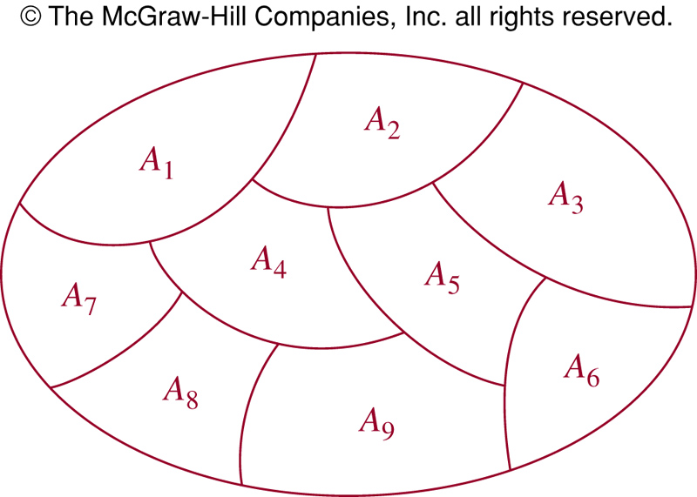
Equivalence classes and partitions
Recall that a partition of a set S is
  a set of sets {A₁, A₂, ..., A_{n}} such that
    each A_{i} is a non-empty subset of S,
    all pairs A_{i} and A_{j} are disjoint (i.e., A_{i} ∩ A_{j} = ∅),
    S = U_{i} A_{i} (that is, all elements of S are in some A_{i})

Slide 18
Equivalent classes form a partition and viceversa
Theorem:
  The equivalence classes of any equivalence relation R on set S form a partition of S.
  Conversely, any partition of S corresponds to an equivalence relation whose equivalent classes are the partition.

Slide 19
Part 1 of Theorem
Assume we are given an equivalence relation R of a set S.
Let R have n equivalence classes
[a₁], [a₂], . . . , [a_{n}]
Define the subsets {A₁, A₂, ... , A_{n}} of S as follows.
A_{i} = { x | x ∈ [a_{i}] }
Then, {A₁, A₂, ... , A_{n}} forms a partition of S

Slide 20
Part 2 of Theorem
Assume we are given a partition {A₁, A₂, ..., A_{n}} of a set S.
Let us define a relation R as follows:
a R b iff there is an i such that a ∈ A_{i} and b ∈ A_{i}
Then,
    R is an equivalence relation, and
    for every a ∈ A_{i} we have that [a] = A_{i}

Slide 21
Proof of part 1: equivalence classes form a partition
First, each equivalence class is a non-empty subsets of S. Why?
  An equivalence class [a]_{R} is defined w.r.t. an element a of S
  R is reflexive, so a is in [a]_{R} (not empty)
  For any b in [a]_{R}, (a,b) in R, and the domain of R is S, thus b is also in S. I.e., all elements of [a]_{R} are in S
Second, the union of the equivalence classes equals S
  This is because any element b of S belongs to at least one equivalence class, namely, [b]

Slide 22
(continued)
Finally, let [x] and [y] be two equivalence classes. We need to show that these are disjoint or they are identical.
We assume that their intersection is non-empty (i.e., they are not disjoint) and prove that they have the same elements
  If z ∈ [x] and z ∈ [y], and if b ∈ [x],
    then by definition of R: z R x, and z R y, b R x.
    by symmetry: x R z,
    from transitivity of b R x, x R z, and z R y, we get b R y,
    I.e., any element b in [x] is also in [y] (a similar argument shows that any element in [y] is also in [x])
    I.e., [x] = [y].
We are done. We have showed that
  every element of S is in some equivalence class, that
  each equivalence class contains only elements of S,
  and that the equivalence classes are disjoint.
  Hence, equivalence classes form a partition of S.

Slide 23
Proof of part 2: a partition defines an equivalent relation
Let {A₁, A₂, ..., A_{n}} be any partition of S.
Consider the relation R: {(x, y) | x and y belong to the same A_{i}}. Is R an equivalence relation?
    x R x since any element x of S belongs to some partition A_{i} –– thus R is reflexive
    x R y implies y R x since if x belongs to the same set as y, then obviously y is in the same set as x, hence –– symmetric
    x R y and y R z implies that x R z since if x belongs in the same set as y and y in the same set as z, then x is also in the same set as z –– transitive

Slide 24
(continued)
We know R is an equivalence relation, and thus has equivalence classes.
Does each A_{i} in the partition of S is the same as an equivalent class in R?
  Consider any element x ∈ S.
  Let x ∈ A_{i}.
  Consider the equivalent class [x]_{R}. Any element y in [x]_{R} should also be an element of A_{i}
    By definition,
    y ∈ [x]_{R} iff
    x R y iff
    there is a j s.t. x and y are in the same A_{j} iff
    {from x ∈ A_{i} assumption and A’s are disjoint}
    y ∈ A_{i}
  Hence, each A_{i} is identical to an equivalence class

Slide 25
Example
What are the equivalence classes for congruence modulo 4?
  [0] = {0, ±4, ±8, ±12, ...}
  [1] = {1, -3, 5, -7, 9, -11, 13, ...}
  [2] = {2, -2, 6, -6, 10, -12, 14, ...}
  [3] = {3, -1, 7, -5, 11, -13, 15, ...}
These sets are disjoint
Every integer is in one of these sets
Hence, a partition

Slide 26
Another example
Let S = {all 0-1 strings}
a R b iff (a = b) ∨
(|a| ≥ 3 ∧ |b| ≥ 3 ∧ first3(a) = first3(b))
Equivalence classes:
  [0] = {0}, [1] = {1},
  [01] = {01}, [10] = {10}, [00]={00}, [11]={11}
  [000] = {000, 0000, 0001, 00000, 00001, 00010, 00011, …}
  [001] = {001, 0010, 0011, 00100, 00101, 00110, 00111, …}
  …
  [111] = {111, 1110, 1111, 11100, 11101, 11110, 11111, …}

Slide 27
Partially ordered sets
Partial orders (relations that are reflexive, antisymmetric, and transitive) can be used to order the elements of a set
A set S together with a partial order R is called a partially ordered set or poset (S, R).

